Slide 1
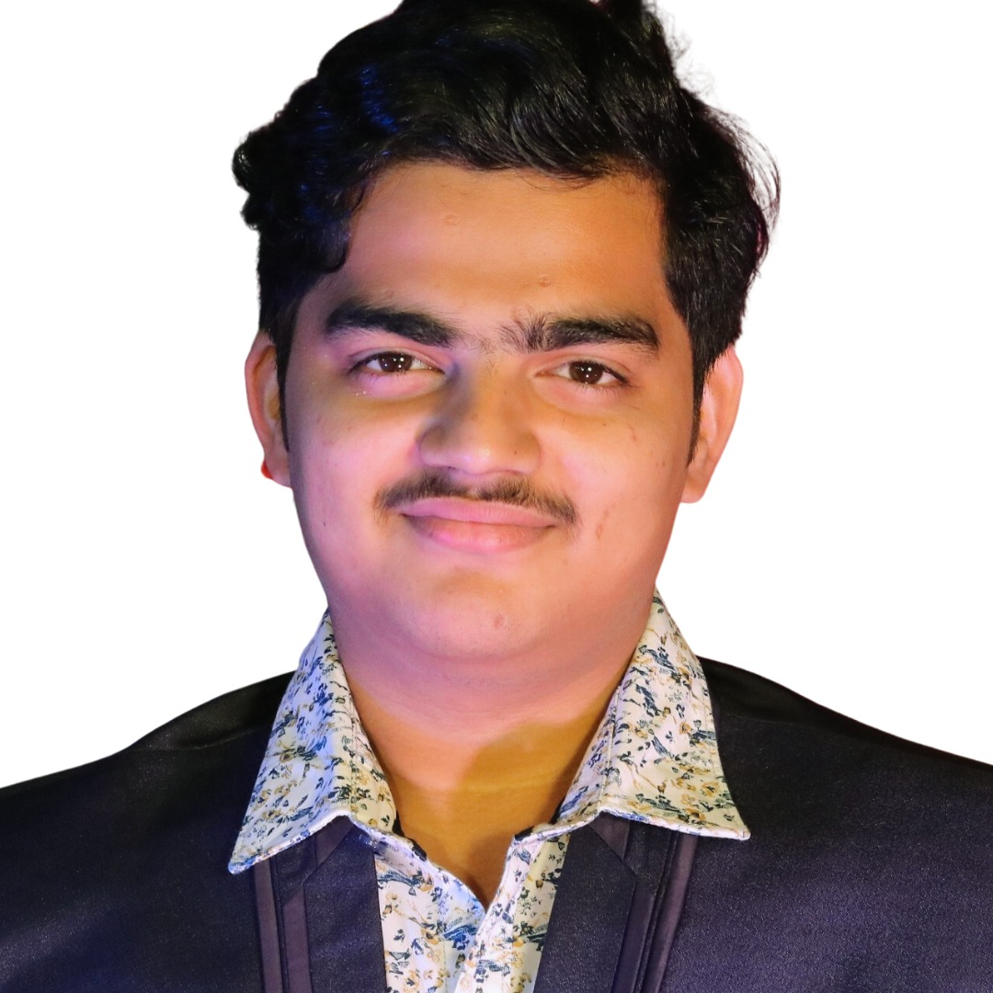
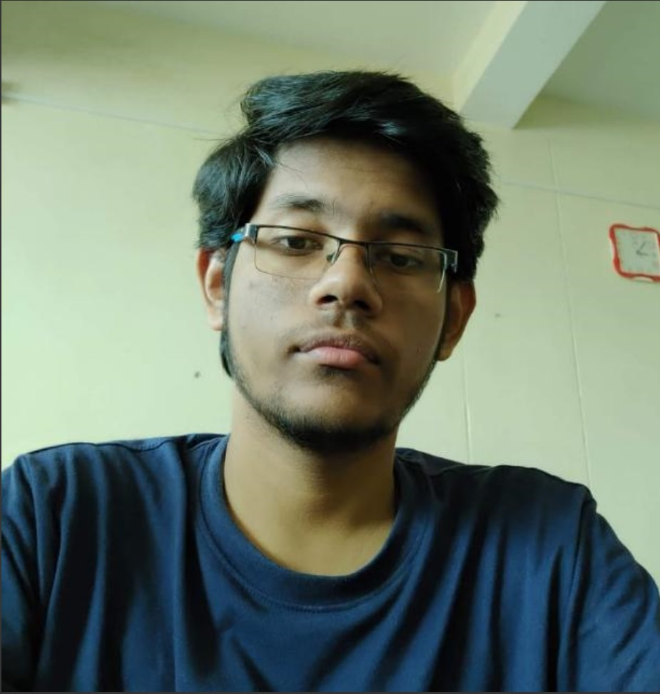
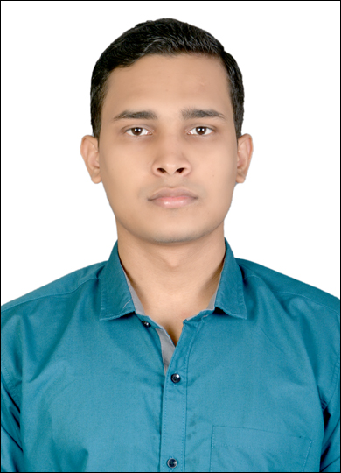
Meet The Developers
TEAM NAME : CaffeineCoders
Siddhanta Choudhury
Pratyusha Kumar Kar
Aditya Sadangi

Slide 2
Problem Statement
To develop an Event Management App that leverages the power of MobileNetV2 in OpenVINO for real-time object detection to enhance event planning and execution. This app should enable event organizers to efficiently monitor and manage crowd counting ,crowd dynamics, ensuring optimal safety, resource allocation, and participant experience during various events, from concerts and conferences to sports matches and festivals. The app should provide a user-friendly interface, allowing organizers to access live video feeds, receive crowd insights, and make informed decisions to improve event outcomes.
Assumptions : 1. Camera Placement : Either 4-5m from the ground , or headlevel of the crowd if necessary. (drone view preferred )
2.Visibility : Atleast 10-15 percent of the person’s body should be visible to register as a person , from any height or angle above eye level
3.Privacy and Ethical Considerations : Since no personal data on any detected person is stored or used , and people are rather used like objects in this model , it does not require many privacy based agreements to run in public places.

Slide 3
Solution Breakdown and Features
The app offers a comprehensive set of features aimed at enhancing event planning and execution. It enables event organizers to access live video feeds from event venues, perform crowd counting, and analyze crowd density in real time. The app's key components include:
Real-Time Monitoring: The app provides event organizers with a live video feed from event venues, allowing them to oversee attendee activities in real time.
Object Detection: MobileNetV2 is used to detect and count people within the frame, providing an estimate of the crowd size.
Crowd Density Analysis: The app generates crowd density maps, helping organizers identify crowded areas and potential bottlenecks.
Security and Safety: It assists in enhancing security and safety by identifying anomalies or security breaches within the crowd.
Data-Driven Insights: Organizers can make informed decisions about resource allocation, event planning, and logistics based on data-driven insights.
Scalability: The solution is designed to be scalable, accommodating events of varying sizes, from small gatherings to large-scale festivals.

Slide 4
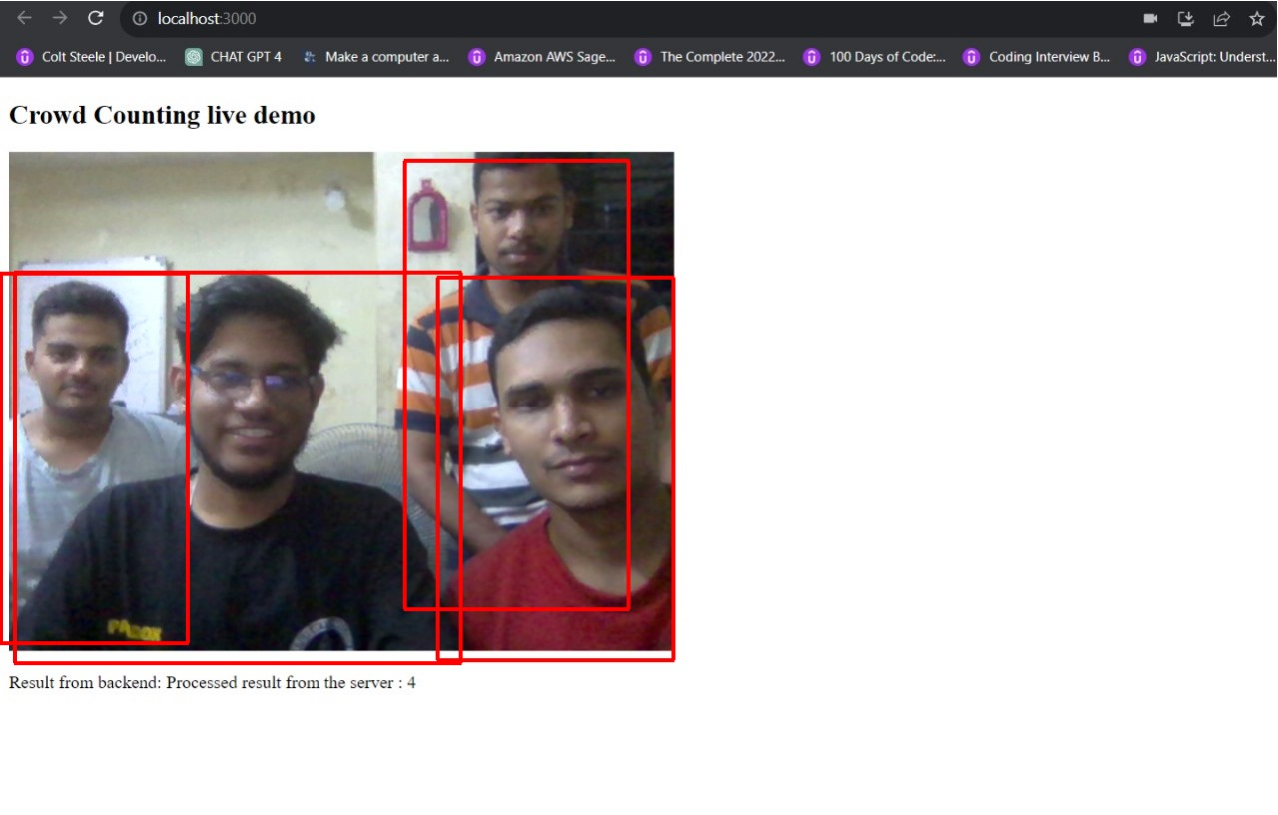
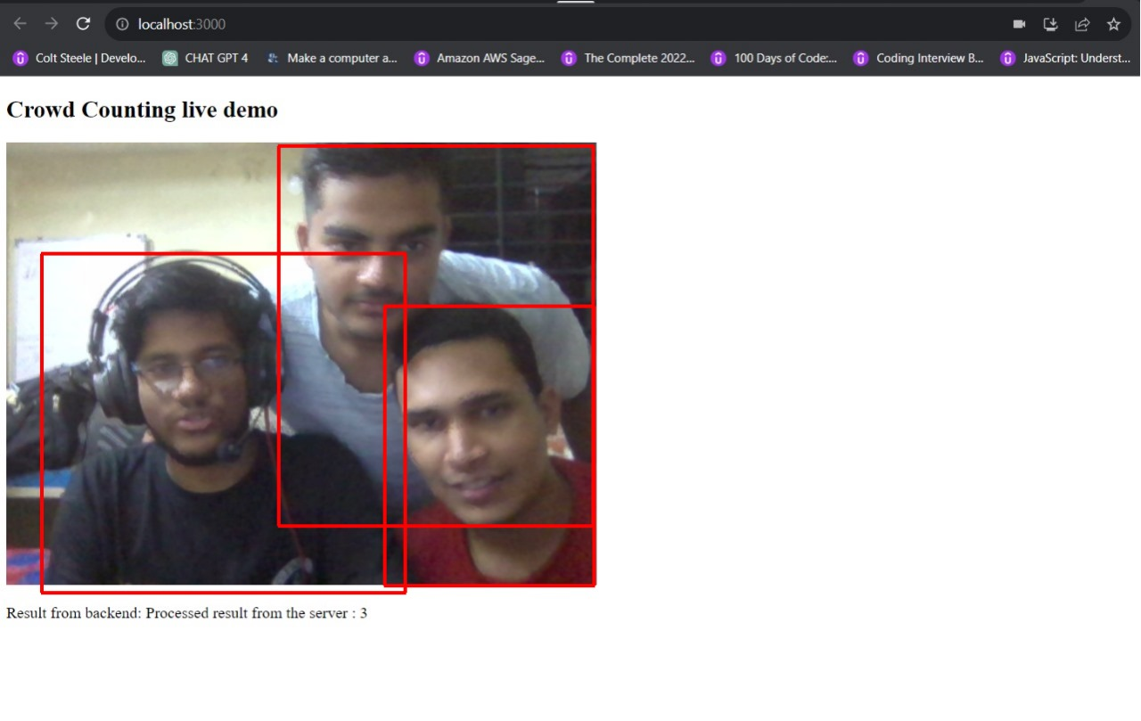
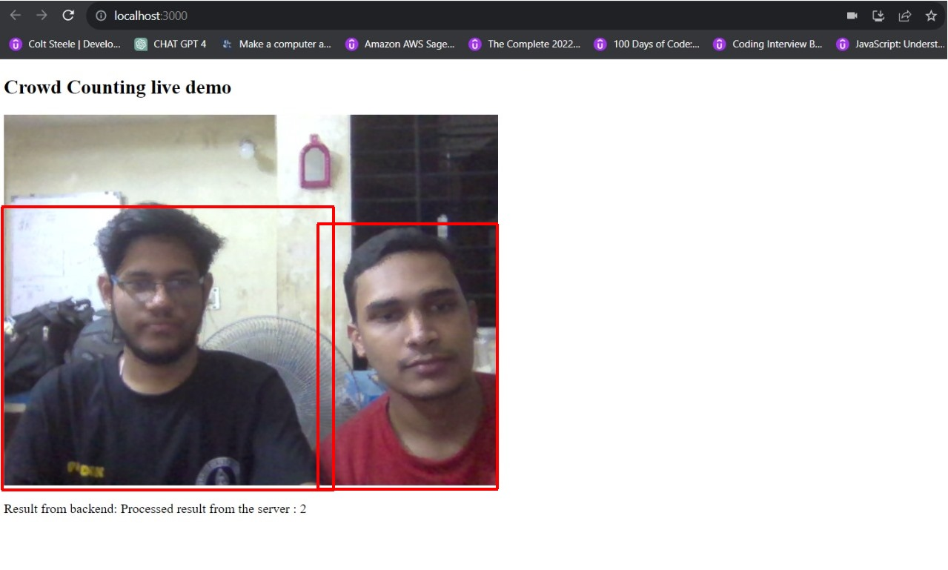
Crowd counting in Action

Slide 5
Our Approach on Crowd Counting (people detection )
 | App Logic
01 | Keep running this system on a livestream video. This can be anything ranging from security cameras to mobile devices / drones. The video is streamed as frames into the python script which is running the model for inference.
02 | Detects the number of people present in a frame and keeps track of their movements ( can be saved and mapped to generate a heatmap like gui , work in progress ) Also stores and shows the inference data back to the organizers console to mobilize.
03 | This program will use MobileNetV2 from Pytorch and ONNX , the .bin and .xml obtained from the OpenVINO Zoo , for person tracking.
Objective: The objective of a App is to quickly and accurately detect crowd count and movement in real-time using cameras and notify organisers to plan and manage a venue according to the present crowd. This app aims to enhance crowd safety by providing timely alerts, reducing response time, and preventing potential stampede disasters. It ensures that crowd can be managed in times of crisis or can be managed with ease by studying movement patterns in a venue and placing security measures accordingly.
Technology stack: Node.js , Express.js server running Python script on async with OpenVINO for backend, OpenCV, PyTorch, React.js and websockets with socket.io
Key Features: Can detect and track movements of multiple people in a crowd and will generate a heatmap of their movements to enable proper crowd security and analysis for sound crowd movement and management.
Real-time Detection: Instantly identifies if a person is in a frame with good amount of distance coverage , and can track their general movement in real time.

Slide 6
Thank You

